Slide 1
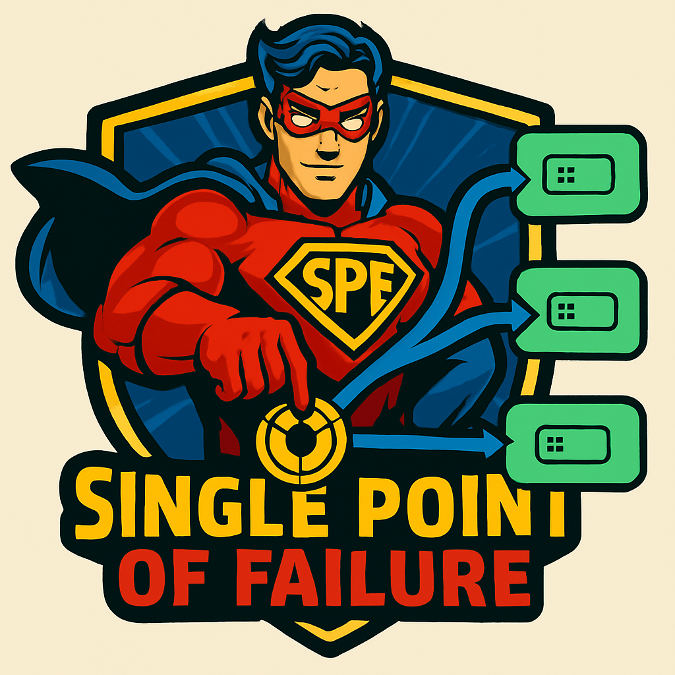
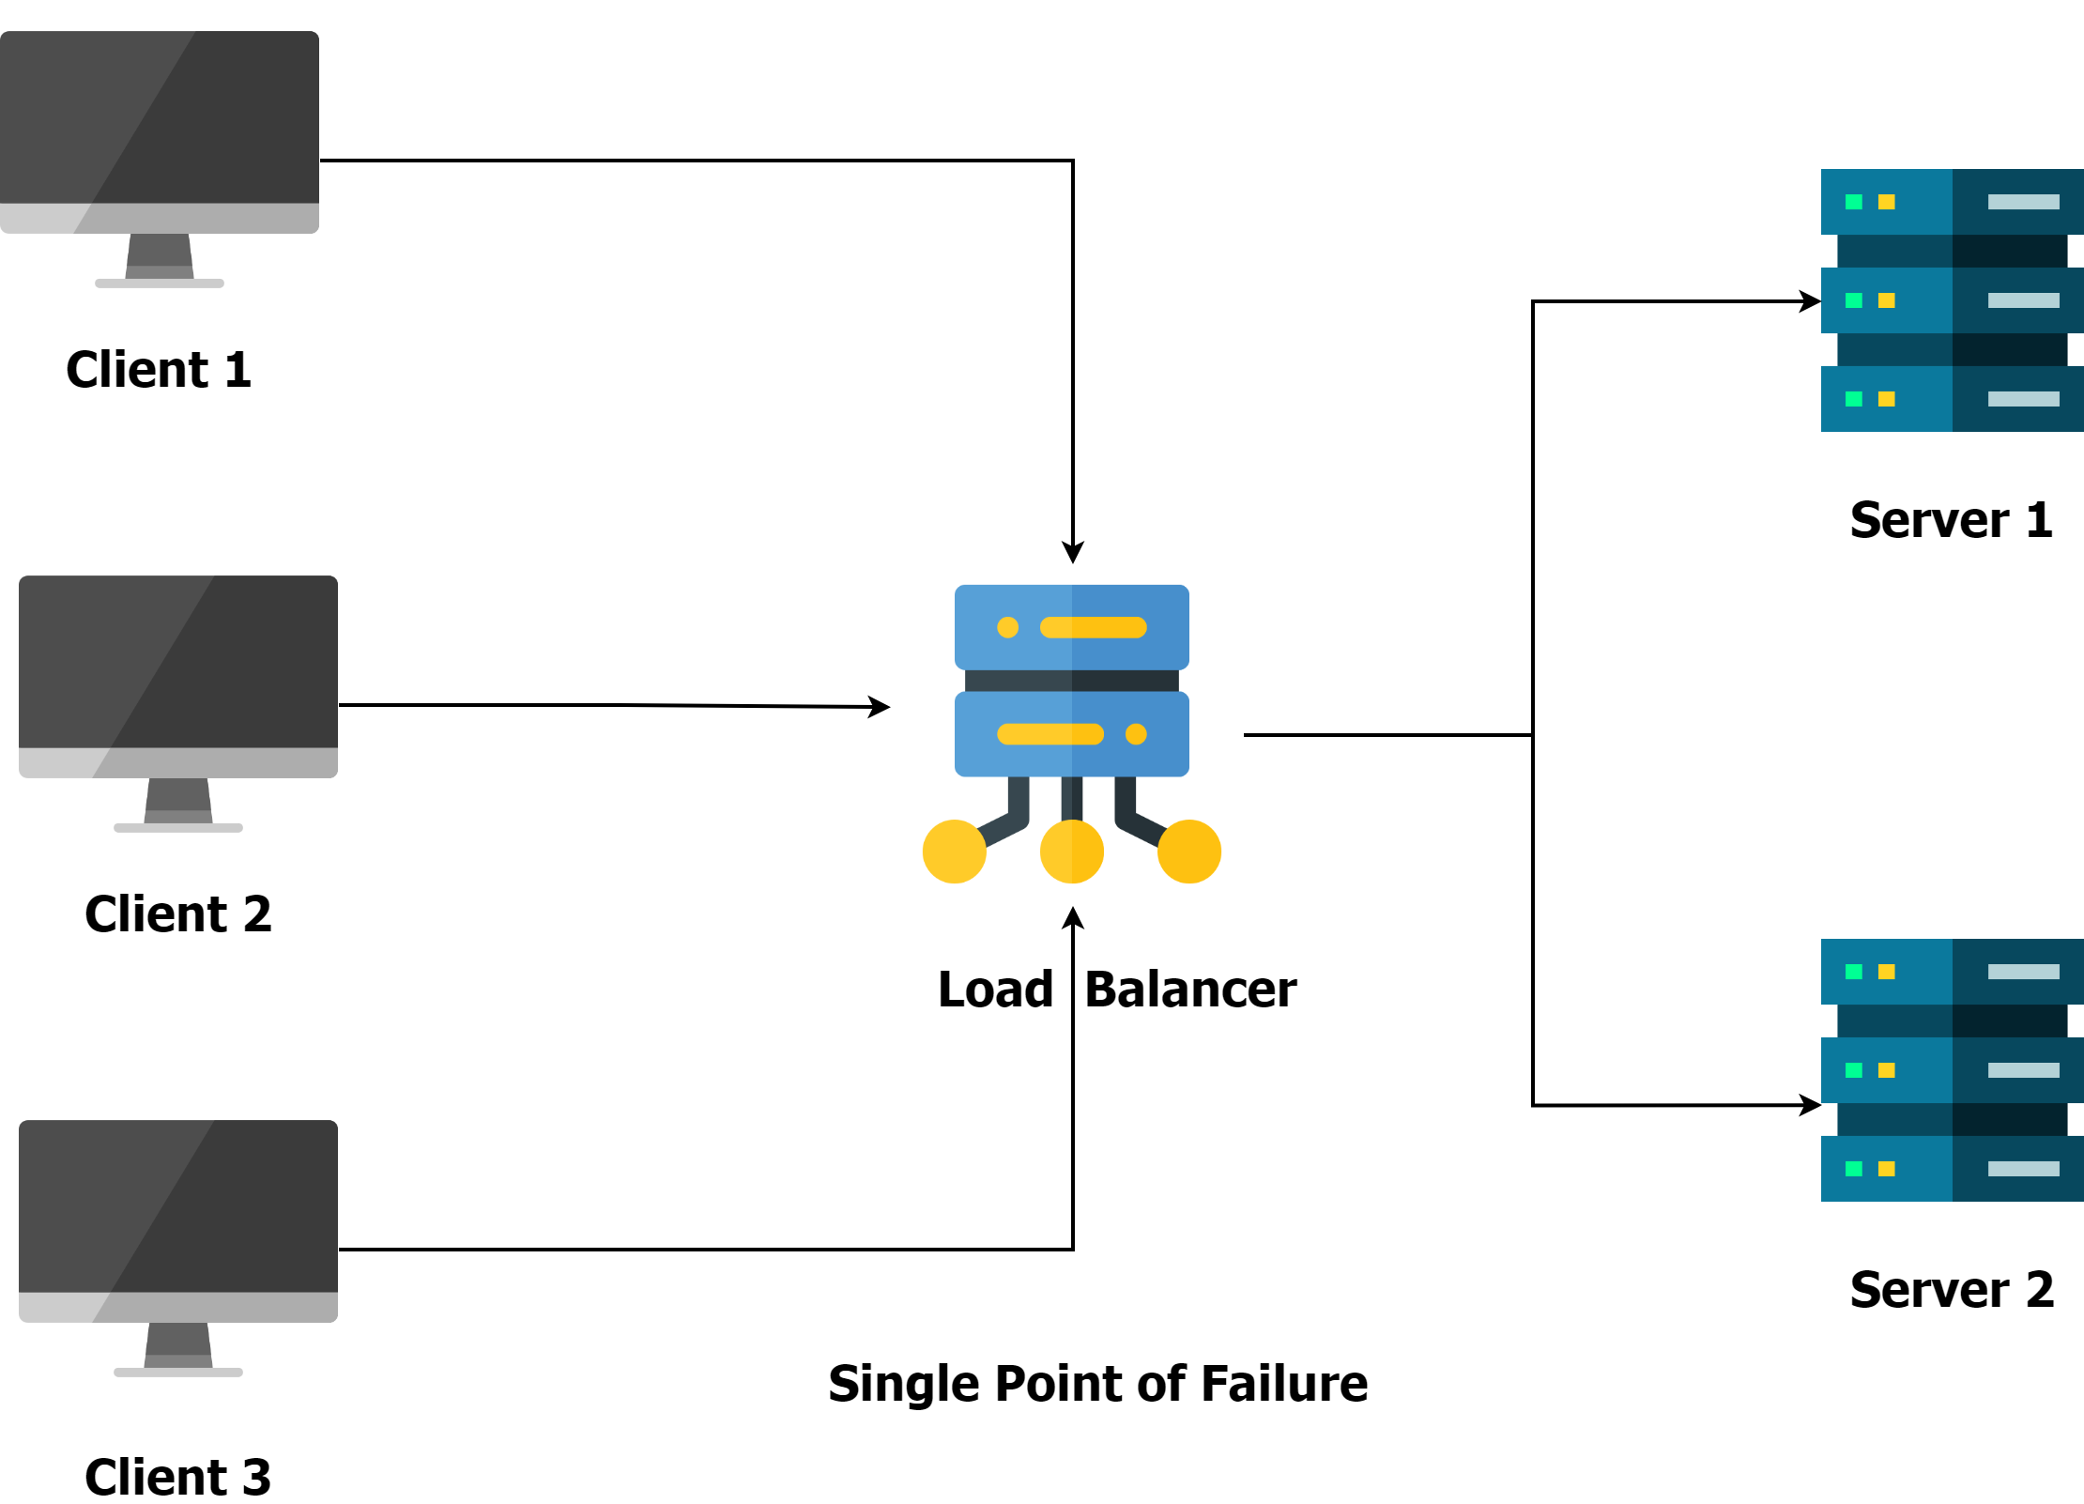
What is Single Point of Failure (SPOF) ?
A Single Point of Failure (SPOF) is a component in your system whose failure can bring down the entire system, causing downtime, potential data loss, and unhappy users.
In the below example, if there is only one instance of the load balancer, it becomes a SPOF. If it goes down, clients won’t be able to communicate with the servers.
By minimizing the number of SPOFs, you can improve the overall reliability and availability of the system.

Slide 2
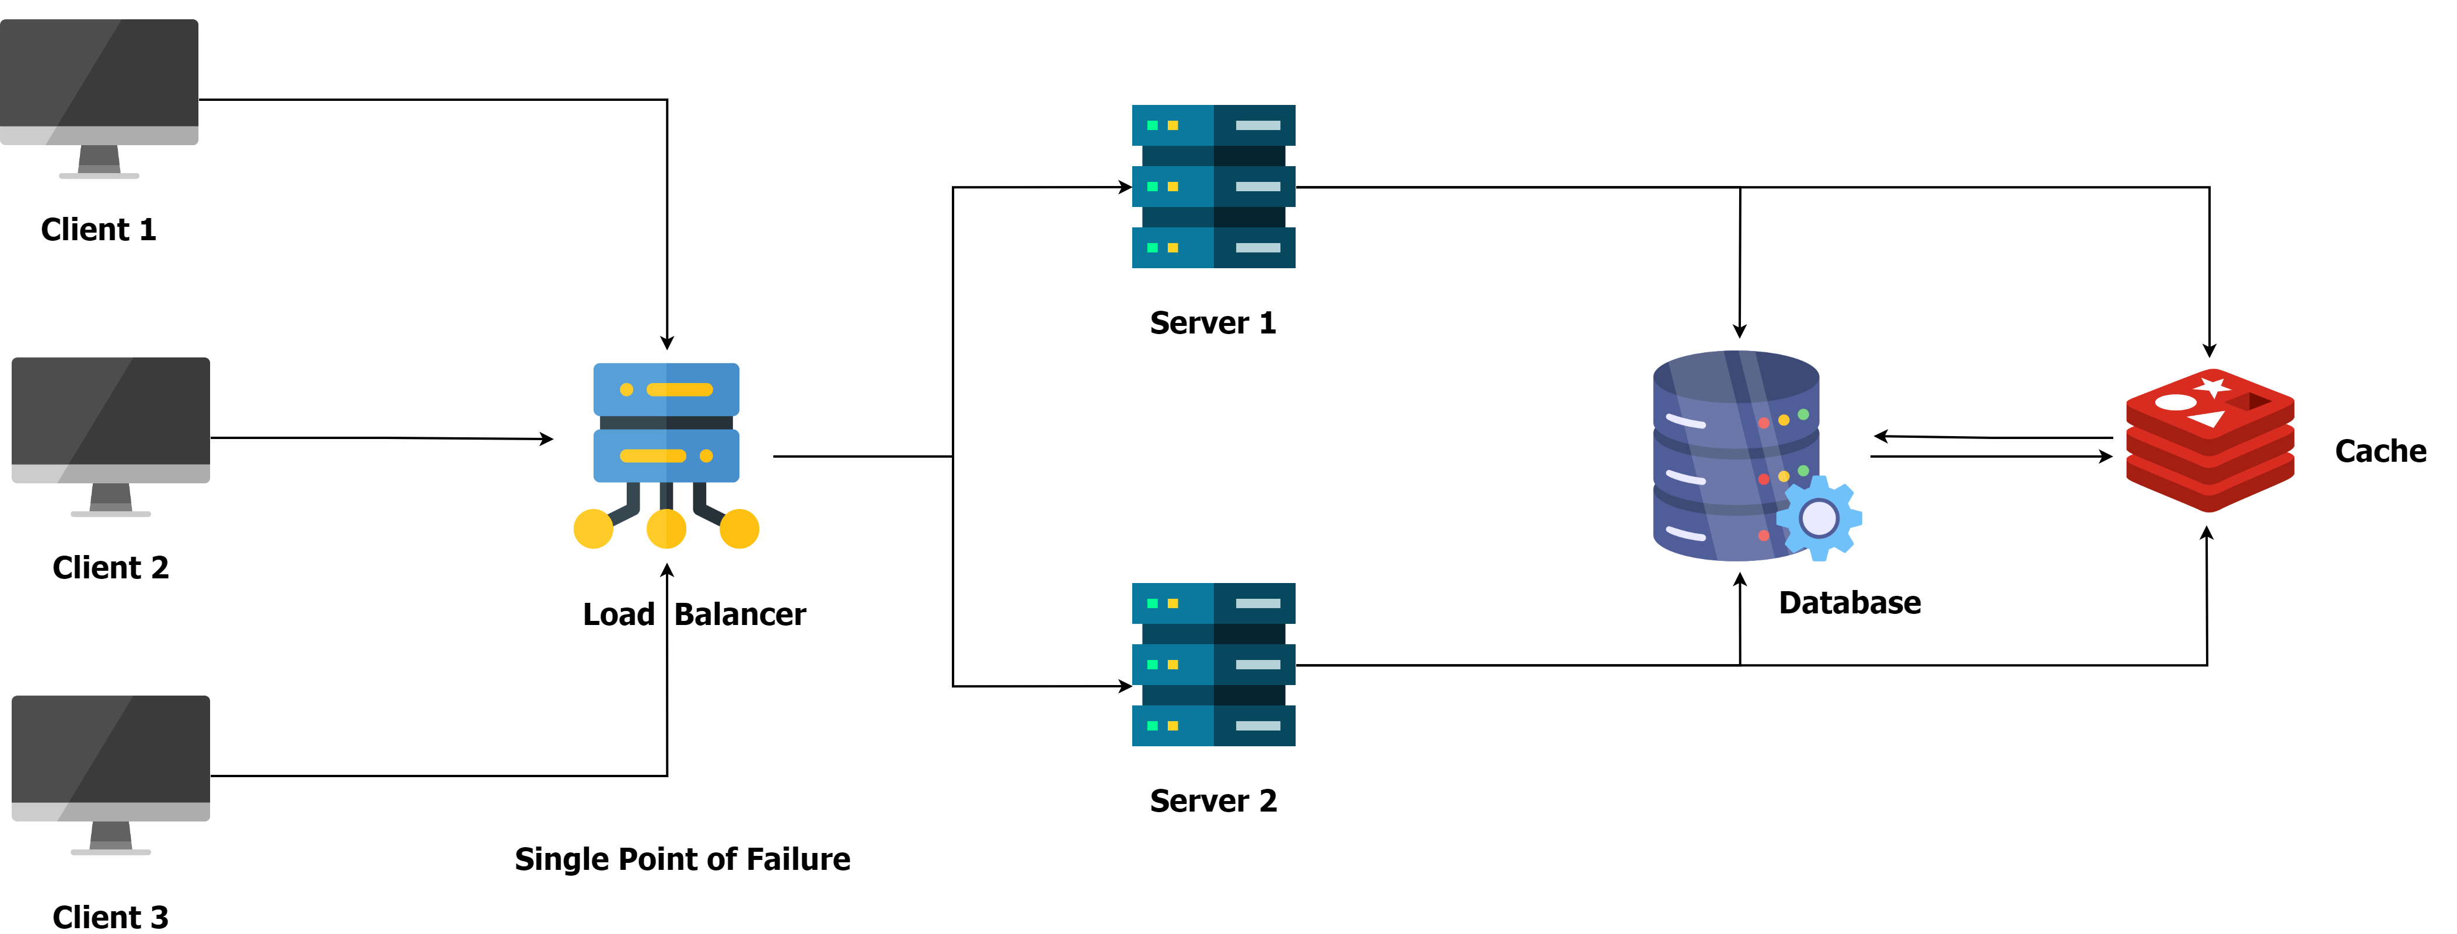
Understanding Single Point of Failure (SPOF)
A Single Point of Failure (SPOF) is any component within a system whose failure would cause the entire system to stop functioning.
In distributed systems, failures are inevitable. Common causes include hardware malfunctions, software bugs, power outages, network disruptions, and human error. In system design, SPOFs can include a single server, network link, database, or any component that lacks redundancy or backup.
Let’s see an example of a system and various single points of failures in it:
Load Balancer: If there is only one load balancer instance and it fails, all traffic will stop, preventing clients from reaching the application servers. To avoid this, we can add a standby load balancer that can takeover if the primary one fails.
Database: With only one database, its failure would result in data being unavailable, causing downtime and potential data loss. We can avoid this by replicating the data across multiple servers and locations.
Cache Server: The cache server is not a true SPOF in the sense that it doesn’t bring the entire system down. When it’s down, every request hits the database, increasing its load and slowing response times.

Slide 3
How to Identify SPOFs in a Distributed System
1. Map Out the Architecture
Create a detailed diagram of your system's architecture. Identify all components, services, and their dependencies. Look for components that do not have backups or redundancy.
2. Dependency Analysis
Analyze dependencies between different services and components. If a single component is required by multiple services and does not have a backup, it is likely a SPOF.
3. Failure Impact Assessment
Assess the impact of failure for each component. Perform a "what if" analysis for each component.
Ask questions like, “What if this component fails?” If the answer is that the system would stop functioning or degrade significantly, then that component is a SPOF.
4. Chaos Testing
Chaos testing, also known as Chaos Engineering, is the practice of intentionally injecting failures and disruptions into a system to understand how it behaves under stress and to ensure it can recover gracefully.
Chaos engineering often involves the use of tools like Chaos Monkey (developed by Netflix) that randomly shut down instances or services to observe how the rest of the system responds.

Slide 4
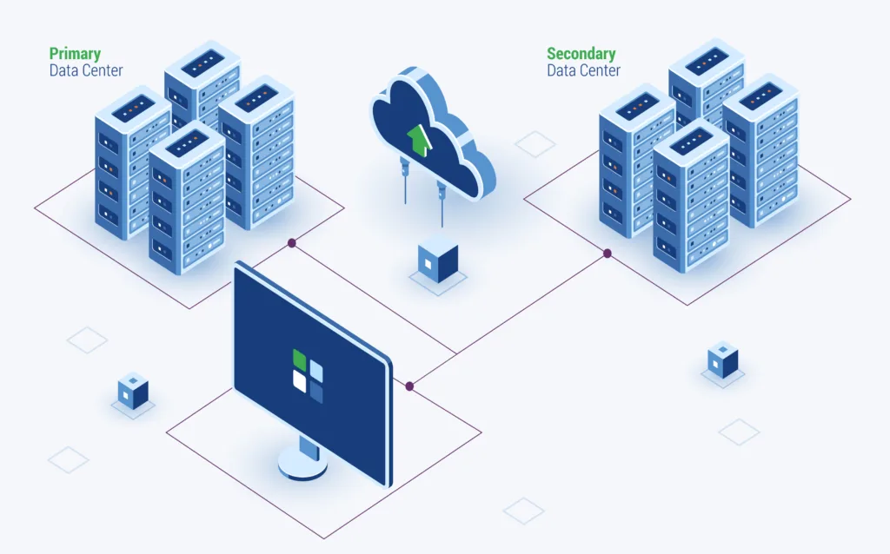
Strategies to avoid Single Point Of Failures (SPOF)
Redundancy
Redundancy involves having backup components that can take over when primary components fail.
Techniques:
Server Redundancy: Deploying multiple servers to handle requests, ensuring that if one server fails, others can continue to provide service.
Database Redundancy: Creating a replica database that can take over if the primary database fails.
Geographic Redundancy: Distributing resources across multiple geographic locations to mitigate the impact of regional failures.

Slide 5
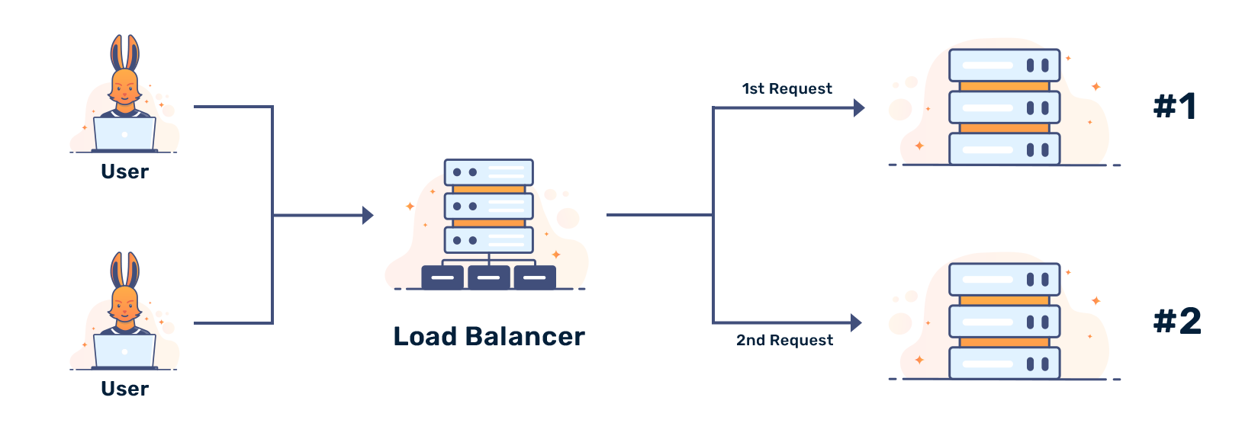
Strategies to avoid Single Point Of Failures (SPOF)
Load Balancing
Load balancing distributes incoming network traffic across multiple servers to ensure no single server becomes a bottleneck, enhancing both performance and availability.
Techniques:
Hardware Load Balancers: Physical devices that distribute traffic based on pre-configured rules.
Software Load Balancers: Software solutions that manage traffic distribution, such as HAProxy, Nginx, or cloud-based solutions like AWS Elastic Load Balancer.

Slide 6
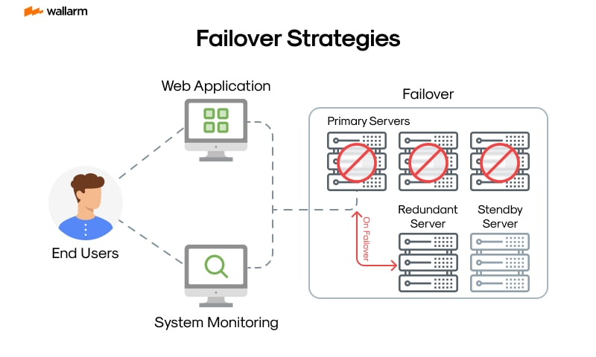
Strategies to avoid Single Point Of Failures (SPOF)
Failover Mechanisms
Failover mechanisms automatically switch to a redundant system when a failure is detected.
Techniques:
Active-Passive Failover: A primary active component is backed by a passive standby component that takes over upon failure.
Active-Active Failover: All components are active and share the load. If one fails, the remaining components continue to handle the load seamlessly.

Slide 7
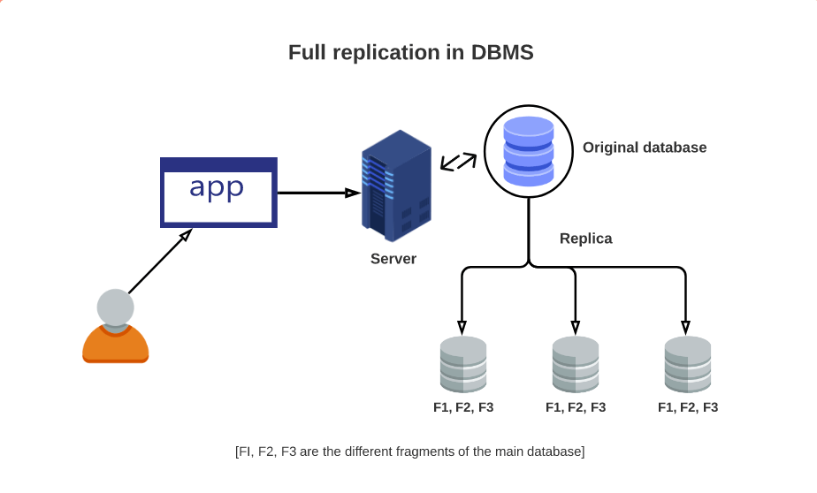
Strategies to avoid Single Point Of Failures (SPOF)
Data Replication
Data replication involves copying data from one location to another to ensure that data is available even if one location fails.
Techniques:
Synchronous Replication: Data is replicated in real-time to ensure consistency across locations.
Asynchronous Replication: Data is replicated with a delay, which can be more efficient but may result in slight data inconsistencies.

Slide 8
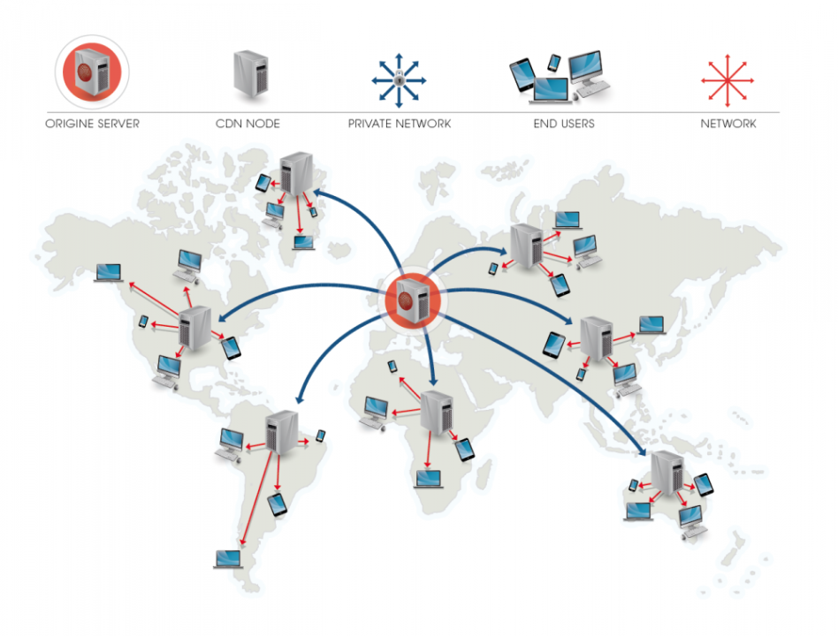
Strategies to avoid Single Point Of Failures (SPOF)
Geographic Distribution
Distributing services and data across multiple geographic locations mitigates the risk of regional failures.
This includes using:
Content Delivery Networks (CDNs) to distribute content globally, improving availability and reducing latency.
Multi-Region Cloud Deployments to ensure that an outage in one region does not disrupt your entire application.

Slide 9
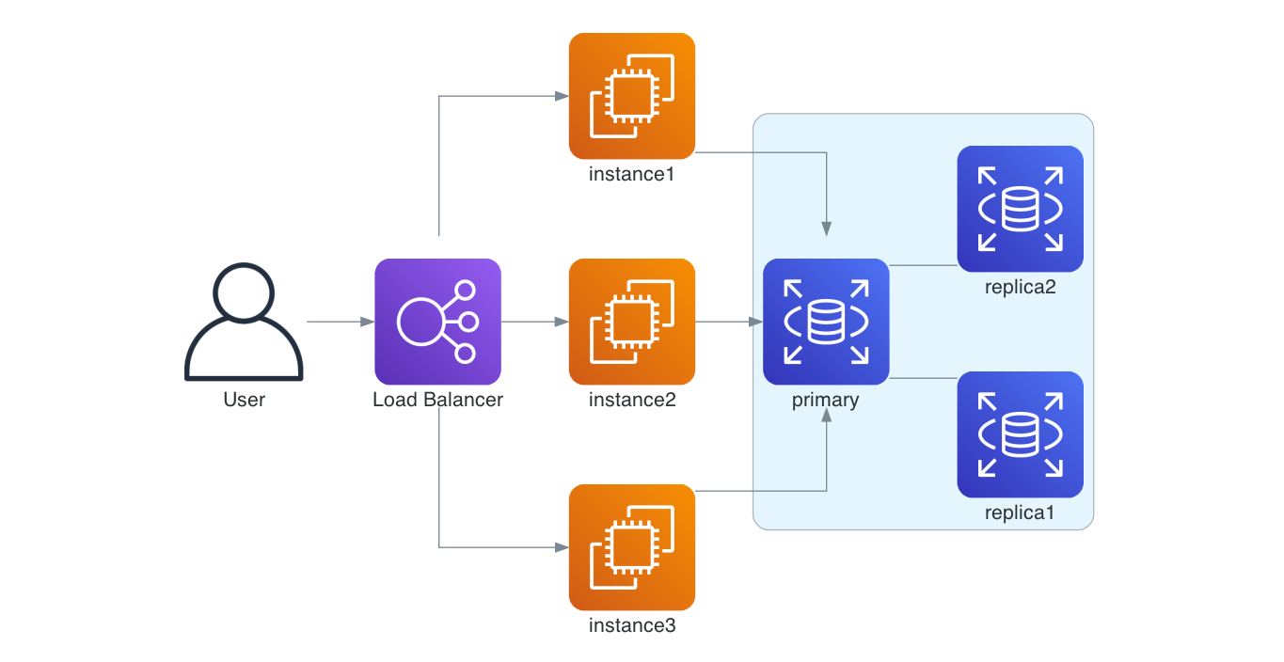
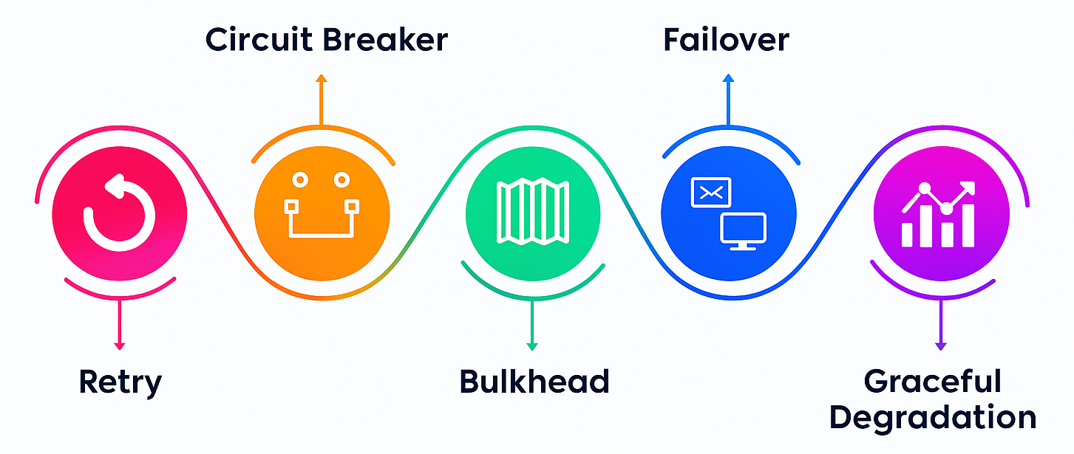
Strategies to avoid Single Point Of Failures (SPOF)
Graceful Handling of Failures
Design applications to handle failures without crashing.
Example: If a service that provides user recommendations fails, the application should still function, perhaps with a message indicating limited features temporarily.
Implement failover mechanisms to automatically switch to backup systems when failures are detected.

Slide 10
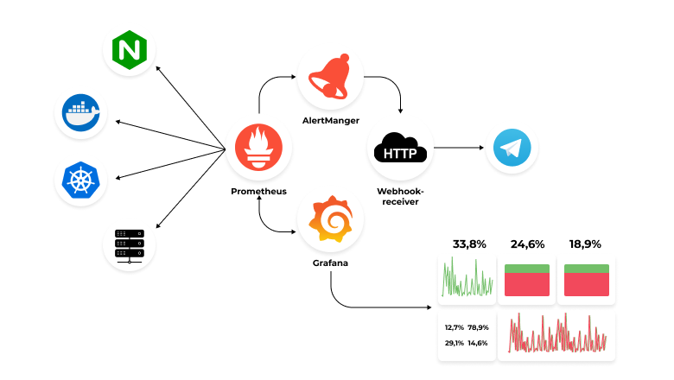
Strategies to avoid Single Point Of Failures (SPOF)
Monitoring and Alerts
Continuous health monitoring involves checking the status of system components to detect failures early and trigger alerts for immediate action.
Techniques:
Heartbeat Signals: Regular signals sent between components to check their status.
Health Checks: Automated scripts or tools that perform regular health checks on components.
Alerting Systems: Tools like PagerDuty or OpsGenie that notify administrators of detected issues.

